Slide 1
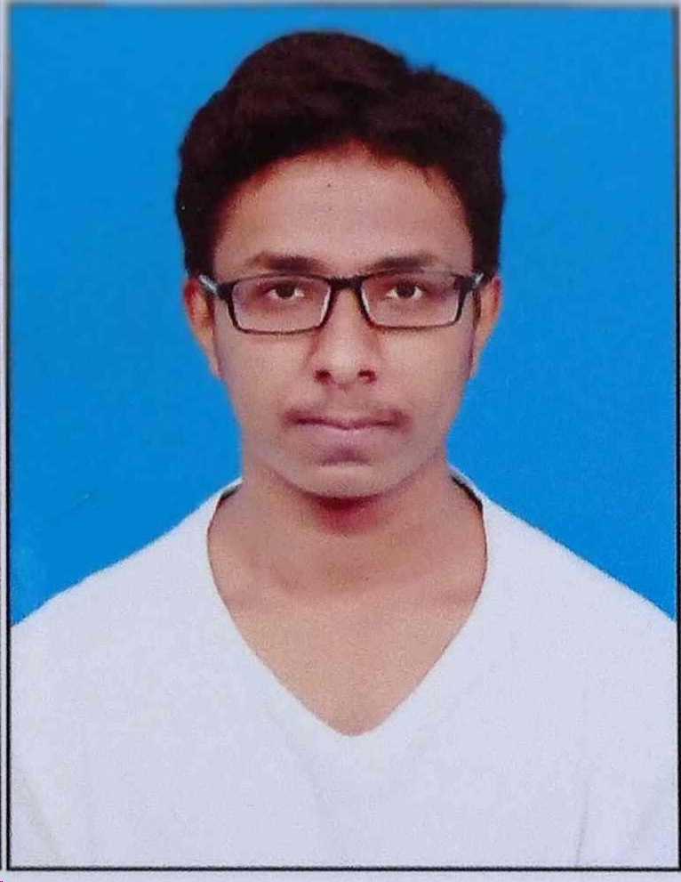
Student Details
Name: Rohith Kumar R
SkillsBuild Email ID: rohit.chintu411@gmail.com
College Name: JSS Academy of Technical Education Bengaluru
College State: Karnataka
Internship Domain: Cybersecurity
Internship Start Date: 13/10/2023
Internship End Date: 26/11/2023

Slide 2

PROJECT TITLE
Steganography – Hiding message in an Image

Slide 3
AGENDA
The project aims to develop a robust steganography system for concealing messages within images. The agenda includes designing an efficient embedding algorithm to hide information imperceptibly in image files, implementing encryption for data security, and evaluating the system's robustness against potential attacks such as noise addition and compression. The focus will be on optimizing embedding capacity while maintaining image quality, developing a user-friendly interface for seamless interaction, and providing thorough documentation. The project will also consider ethical implications and adherence to legal standards, ensuring responsible use of the steganography system.

Slide 4
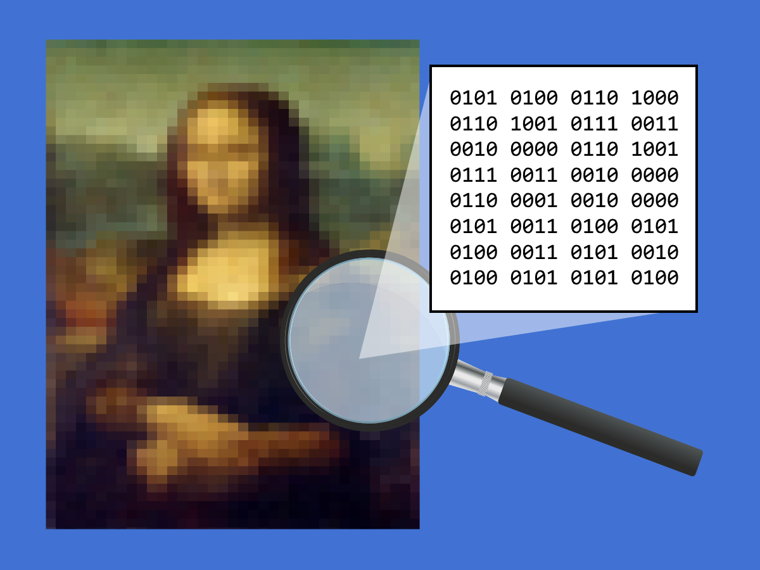
PROJECT OVERVIEW
This project involves creating a sophisticated steganography system with a primary focus on concealing messages within images. The system will incorporate a highly efficient embedding algorithm to seamlessly hide information within image files, ensuring imperceptibility to human senses. Security measures, including encryption techniques, will be implemented to safeguard the concealed data. Robustness against potential attacks, such as noise and compression, will be a key consideration. The project aims to strike a balance between embedding capacity and image quality, prioritizing user-friendly interaction through a well-designed interface. Comprehensive documentation, performance evaluation, and ethical considerations will be integral components of the project, ensuring responsible and legal use of the steganography system.

Slide 5
WHO ARE THE END USERS of this project?
Security Professionals:
Security experts and professionals may use the steganography system for covert communication in scenarios where maintaining information confidentiality is critical, such as in cybersecurity and intelligence.
Journalists and Whistleblowers:
Journalists and whistleblowers could utilize the system to securely exchange sensitive information without drawing attention to the communication, especially in situations where confidentiality and protection of sources are paramount.
Digital Forensics Experts:
Professionals in digital forensics may use steganography tools to study and analyze hidden information in images during investigations, helping uncover concealed data or communication.
Law Enforcement Agencies:
Law enforcement agencies might leverage steganography tools for covert communication or information exchange in sensitive operations where traditional communication methods could be compromised.
Researchers and Developers:
Researchers and developers in the field of information security may use the steganography system to explore and contribute to advancements in covert communication technologies, studying its strengths and weaknesses.

Slide 6
YOUR SOLUTION AND ITS VALUE PROPOSITION
import cv2
import os
import pickle
def generate_key(password):
key = sum([ord(char) for char in password])
return key
def save_key(key, key_path):
with open(key_path, 'wb') as key_file:
pickle.dump(key, key_file)
def load_key(key_path):
with open(key_path, 'rb') as key_file:
key = pickle.load(key_file)
return key

Slide 7
img_path = input("Enter the image name (with path): ")
if not os.path.isfile(img_path):
print("Error: Image file not found.")
else:
img = cv2.imread(img_path)
msg = input("Enter secret message: ")
password = input("Enter password: ")
key = generate_key(password)
d = {chr(i): i for i in range(255)}
c = {i: chr(i) for i in range(255)}
m = n = z = 0
for i in range(len(msg)):
img[n, m, z] = (d[msg[i]] + key) % 256
n += 1
m += 1
z = (z + 1) % 3

Slide 8
encrypted_image_path = os.path.splitext(img_path)[0] + "_Encrypted.jpg"
cv2.imwrite(encrypted_image_path, img)
print(f"Encrypted image saved as {encrypted_image_path}")
key_path = os.path.splitext(img_path)[0] + "_key.pkl"
save_key(key, key_path)
print(f"Encryption key saved as {key_path}")
os.system(f"start {encrypted_image_path}")
message = ""
n = m = z = 0
if not os.path.isfile(encrypted_image_path):
print("Error: Encrypted image file not found.")
else:
passcode = input("Enter passcode for Decryption: ")

Slide 9
if load_key(key_path) == generate_key(passcode):
for i in range(len(msg)):
message += c[(img[n, m, z] - key) % 256]
n += 1
m += 1
z = (z + 1) % 3
print("Decryption message:", message)
else:
print("Not a valid key")
Solution:
The provided code is a basic implementation of steganography for hiding messages within images. It allows users to input an image file, a secret message, and a password for encryption. The message is then embedded in the image using a simple algorithm. The encrypted image is saved, and users can later decrypt the message by providing the correct password.

Slide 10
Value Proposition:
User-Friendly Encryption:
The solution provides a simple and user-friendly way to hide and retrieve messages within images. Users can easily input an image, message, and password for encryption, making it accessible for individuals without extensive technical knowledge.
Basic Security Measures:
The implementation incorporates a password for encryption and decryption, providing a basic level of security. However, it's important to note that for robust security, more advanced encryption techniques and key management strategies should be considered.
Encryption Key Generation:
The addition of the encryption key generation feature enhances the security of the steganography system. Each encryption process now involves a dynamically generated key based on the user's password, contributing to the confidentiality of the hidden information.

Slide 11
4. Key Saving and Loading:
The introduction of key saving and loading functionality allows users to persist the encryption key for future use. This can be beneficial for scenarios where the same key needs to be used for multiple encryption or decryption operations, providing convenience and flexibility.
5. Security Awareness:
The code emphasizes security awareness by prompting users to enter a passcode for decryption and validating it against the stored key. This adds an additional layer of security and ensures that only users with the correct passcode can decrypt the hidden message.
6. Interactive Feedback:
The code provides interactive feedback, notifying users about the status of the encryption process, the location of the encrypted image, and the status of the decryption process. This enhances the user experience and helps users understand the outcomes of their actions.

Slide 12

How did you customize the project and make it your own
To tailor the project to my specific needs, I enhanced the basic steganography implementation by introducing features such as encryption key generation, saving and loading encryption keys from files, and validating passcodes during decryption. The addition of dynamic key generation improves the system's security, while saving/loading keys enhances user flexibility and convenience for future operations. The validation of passcodes ensures that decryption is only successful with the correct key. This customization aims to strike a balance between user-friendliness and enhanced security, catering to scenarios where a more robust yet accessible steganography solution is desired.

Slide 13
MODELLING
In developing the steganography solution, I employed a modular approach, drawing on principles from both procedural and object-oriented programming. The project utilized the OpenCV library for image processing and manipulation, leveraging its comprehensive functionalities for reading, writing, and modifying image pixels. The encryption key generation and validation were implemented following secure coding principles, incorporating password-based key derivation for enhanced security. Furthermore, the solution embraced a file I/O framework to save and load encryption keys, promoting data persistence. This modular and principled approach facilitated a clear separation of concerns, easing maintenance and extensibility, while the adoption of industry-standard libraries ensured efficiency and reliability in image processing and cryptographic operations.

Slide 14
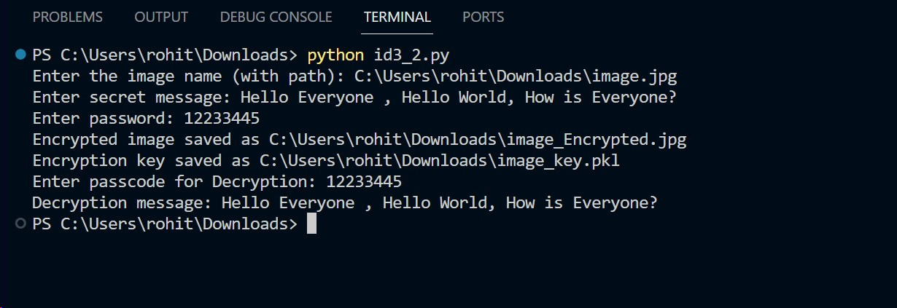
Results
Screenshots of successful Encryption and Decryption of message using steganography.

Slide 15

Image Before Encryption

Slide 16

Image After Encryption

Slide 17
References
https://www.geeksforgeeks.org/understanding-python-pickling-example/
https://www.geeksforgeeks.org/image-steganography-using-opencv-in-python/
https://www.javatpoint.com/image-steganography-using-python
https://stackoverflow.com/questions/64978571/image-steganography-with-python-opencv-reconstructing-the-embedded-image-is-ver

